Slide 1
AQA Law A Level at City of Norwich School Mrs Ragan k.ragan@cns-school.org

Slide 2
What will we be learning?
The nature of law and the English legal system | Criminal law
We will be developing a basic understanding of the distinction between enforceable legal rules and principles and other rules and norms of behaviour, as well as the differences between criminal and civil law and between different sources of law including custom, statute law and the common law. Topics covered include: Law and morality / law and justice / law and society; Parliamentary law making and judicial precedent; The civil and criminal courts. | We will be studying the rules and principles concerning general elements of criminal liability and liability for offences against the person, property offences and attempt, including the specific offences of: Involuntary manslaughter; Murder and voluntary manslaughter; Theft and robbery; Attempts; Defences.
Tort law | Human rights
We will be studying the rules and principles concerning liability and fault in actions for negligence, occupiers' liability, nuisance and vicarious liability, and associated defences and remedies, including the specific torts of: Medical negligence; Nuisance; Occupiers’ liability; Pure economic loss; Negligent misstatement; Vicarious liability; Remedies. | We will take an in depth look at the rules and principles of law relating to the right to life, to liberty and security of person, to privacy, to freedom of expression, and to freedom of assembly and association, as recognised by the European Convention on Human Rights and in the United Kingdom. We will consider the restrictions to these rights and how they are enforced in the UK, in addition to considering any conflicts between these human rights and our domestic law.

Slide 3
Bridging task - need to do
Jury service
Visit the following websites and watch the video about the role of a juror to find out more about jury service in England and then complete the activities on the following slides:
https://www.gov.uk/jury-service – information from the Ministry of Justice about jury service
https://www.lawteacher.net/free-law-essays/criminal-law/the-jury-system.php - the role and importance of the jury
https://www.youtube.com/watch?v=yQGekF-72xQ&t=2s – video about your role as a juror

Slide 4
Need to do - Questions on juries
Which types of cases are juries used in?
Why are juries used to decide cases?
Why is the independence of the jury important?
Who is eligible to sit as a juror?
Who cannot sit as a juror?
Who can defer jury service?
Who can be excused from jury service?
How can the defence or prosecution challenge the use of a juror or jurors on a case?
How many jurors sit on a case?

Slide 5
Need to do - Advantages and disadvantages of using jurors to decide criminal trials
Using the research you have done, fill in the the table below, setting out the advantages and disadvantages of using jurors to decide criminal trials:
Advantages | Disadvantages

Slide 6
Summer task - Nice to do
Lay magistrates
Use the websites below to help you consider the following questions about lay magistrates:
What is the role of a lay magistrate?
Which court do lay magistrates sit in and what kind of cases do they work on?
Who can be a lay magistrate?
Which personal qualities should a magistrate have?
What are the main differences between lay magistrates and jurors?
https://www.gov.uk/become-magistrate
https://www.lawteacher.net/free-law-essays/common-law/the-term-lay-people.php

Slide 7
Additional resources
www.lawteacher.net;
www.e-lawresources.co.uk;
www.legalcheek.com;
www.alevellaw.doomby.com
www.studyrocket.co.uk
www.ials.sas.ac.uk
www.lawsociety.org.uk

Slide 8
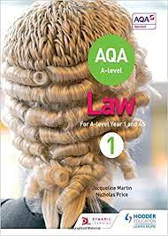
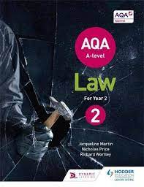
Further course information
We will be studying the AQA 2 year A Level course – the specification can be found at this link: https://www.aqa.org.uk/subjects/law/as-and-a-level/law-7162/specification-at-a-glance
Course textbooks:

