Slide 5
https://www.youtube.com/watch?v=bxWxXncl53U

Slide 8
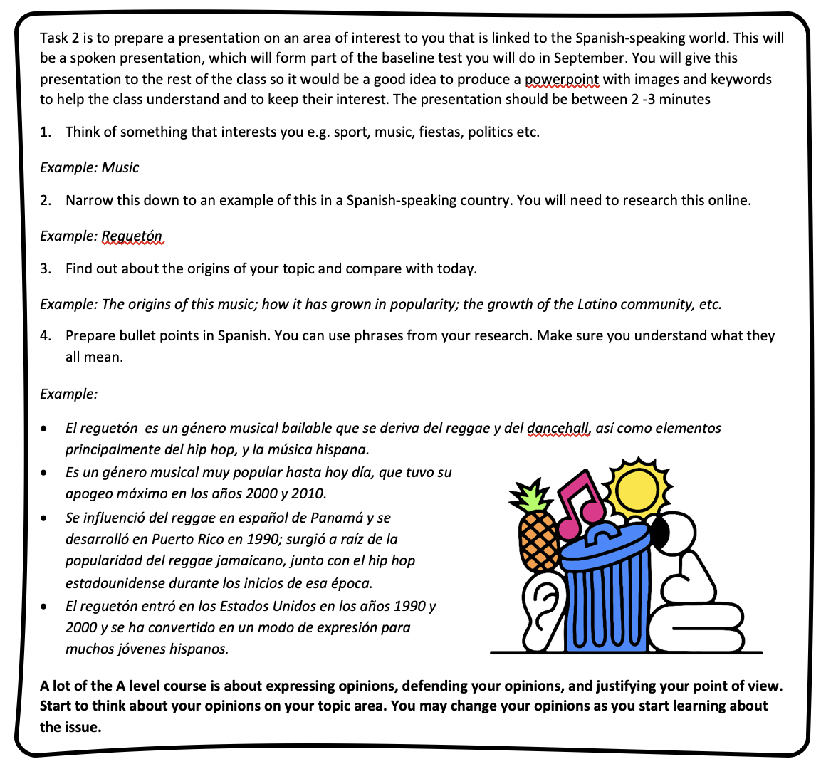

Slide 9
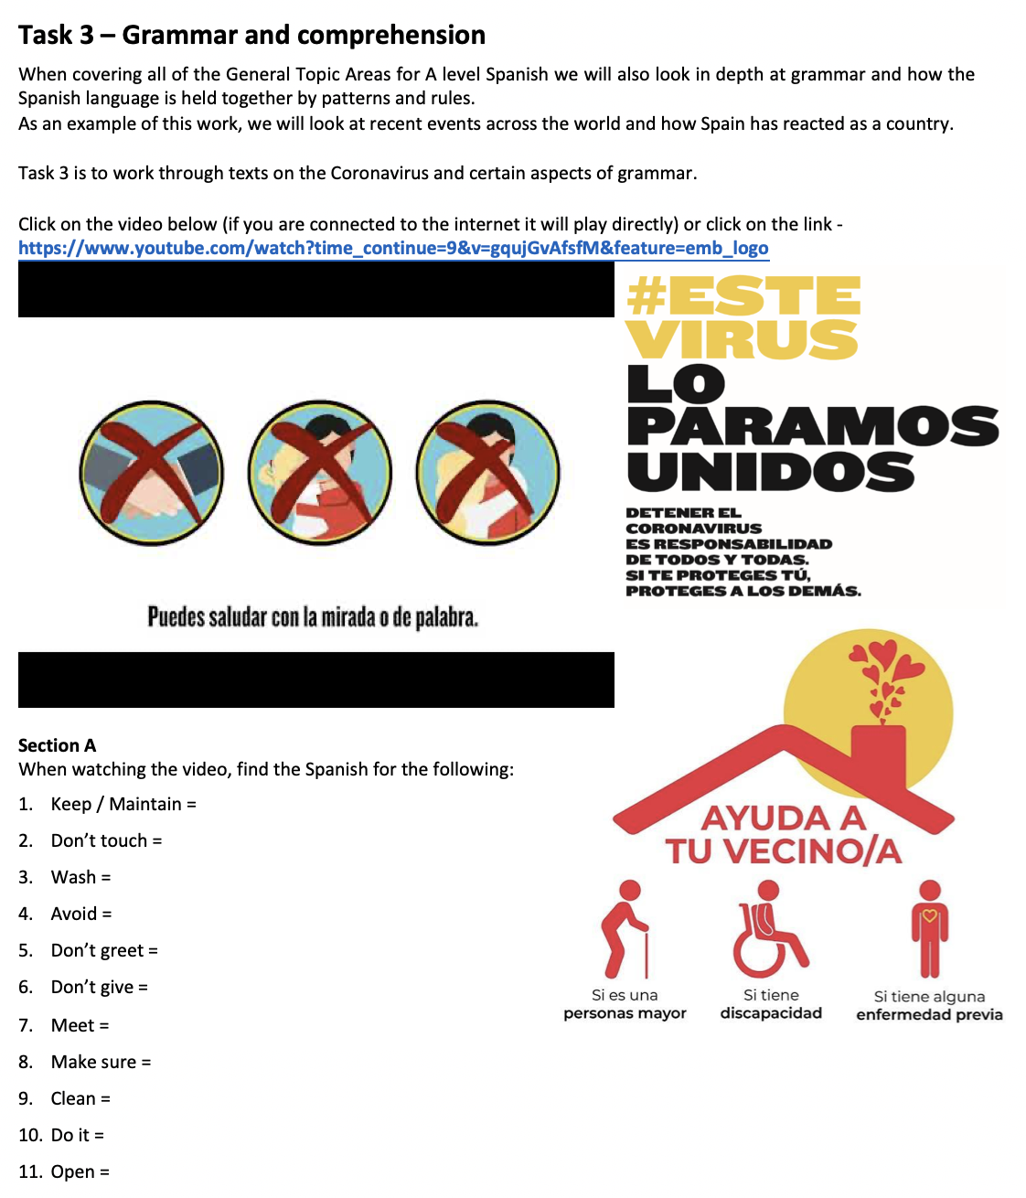
https://www.youtube.com/watch?v=gqujGvAfsfM&t=9s

Slide 10
